Slide 1
Etika & profesi tsi
M5. peraturan & regulasi

Slide 2

Subjectives
Perbandingan Cyber law
Computer crime act (Malaysia)
Council of Europe convention on cyber crime

Slide 3
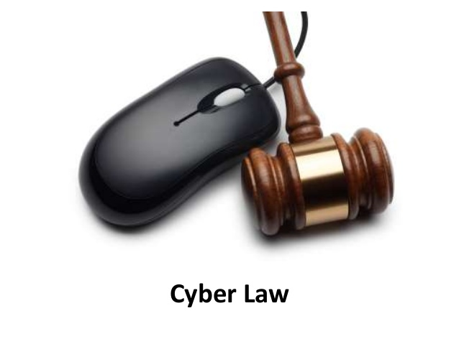

Slide 4
definition
Pavan Duggal, acknowledged as one of the top four Cyber Lawyers in the world, gave a definition of Cyber law in 1996, which is broadly accepted, as follows:

Slide 5
definition
imply speaking, Cyber law is a generic term, which refers to all the legal and regulatory aspects of Internet and the World Wide Web.
Anything concerned with or related to or emanating from any legal aspects or issues concerning any activity of netizens and others, in Cyberspace comes within the ambit of Cyber law.

Slide 6

definition
According to Wikipedia, Cyber Law or Internet law is a term that encapsulates the legal issues related to use of the Internet.

Slide 7
definition
It is less a distinct field of law than intellectual property or contract law, as it is a domain covering many areas of law and regulation.
Some leading topics include internet access and usage, privacy, freedom of expression, and jurisdiction.

Slide 8

definition
Cyberlaw is also known as Cyber Law or Internet Law

Slide 9
definition
Cyberlaw is the area of law that deals with the Internet's relationship to technological and electronic elements, including computers, software, hardware and information systems (IS).

Slide 10

Is Cyber Law
Need It?

Slide 11
Cyberlaw need it
Cyber law is important because it touches almost all aspects of transactions and activities concerning the Internet, the World Wide Web and Cyberspace.

Slide 12
Cyberlaw need it
Cyberlaw concerns everyone.
Cyberlaw is a constantly evolving process.
As the nature and scope of Internet is changing and this new medium is being seen as the ultimate medium ever evolved in human history, every activity of yours in cyberspace can and will have a cyber legal perspective.

Slide 13

What is “all aspects of transactions and activities” mean?

Slide 14
Report
According PewResearchCenter Internet, Science & Tech (www.pewinternet.org) on 25th Sept, 2000 in New Internet Users By John B. Horrigan.

Slide 15
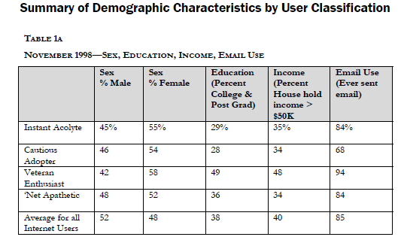
Report

Slide 16
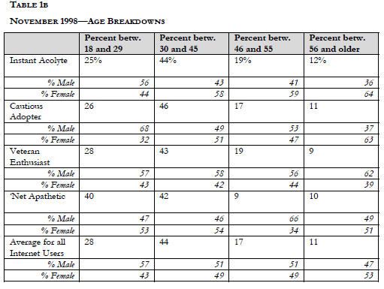
Report

Slide 17
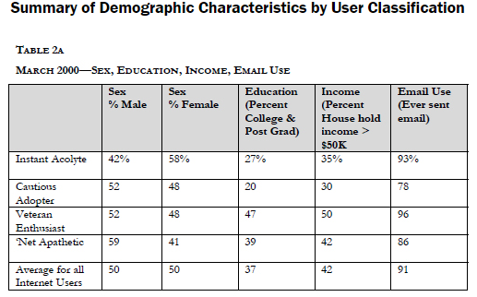
Report

Slide 18
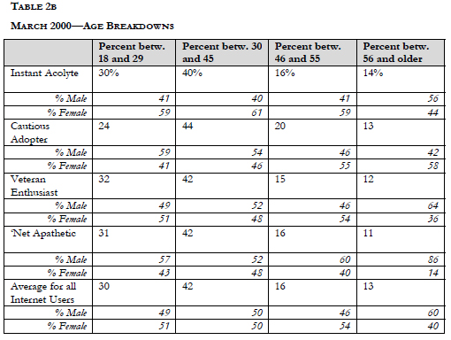
Report

Slide 19
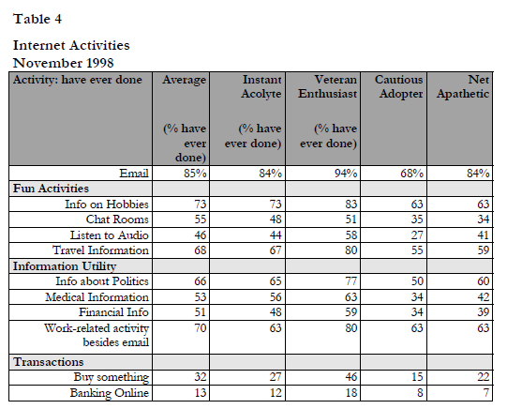
Report

Slide 20
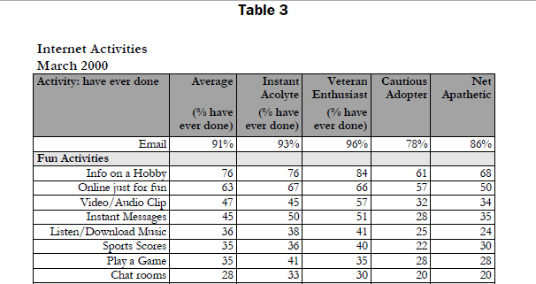
Report

Slide 21
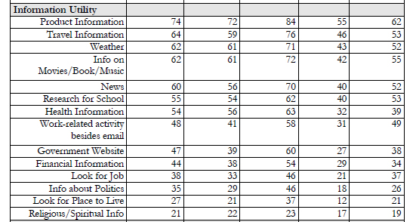
Report

Slide 22
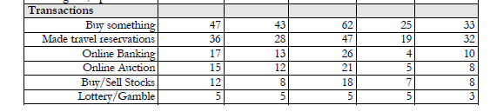
Report

Slide 23
Did you Online Yesterday ?

Slide 24
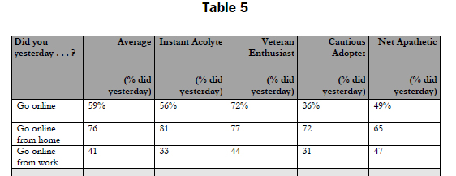

Slide 25
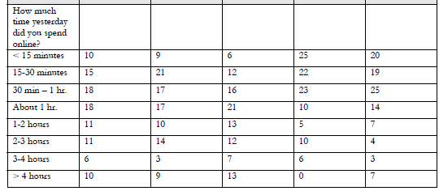

Slide 26

How about now?

Slide 27



Slide 28
IT Act 2000 India, Malaysia Law Computer Crime, & The Council of Europes Convention on Crime

Slide 29

IT Act 2000 India

Slide 30
Cyber Law in India
Url : http://www.cyberlawsindia.net/2sides.html
The internet in India is growing rapidly. It has given rise to new opportunities in every field we can think of – be it entertainment, business, sports or education.

Slide 31
Cyber Law in India
There are two sides to a coin. Internet also has its own disadvantages. One of the major disadvantages is Cybercrime – illegal activitiy committed on the internet.
The internet, along with its advantages, has also exposed us to security risks that come with connecting to a large network.
Computers today are being misused for illegal activities like e-mail espionage, credit card fraud, spams, software piracy and so on, which invade our privacy and offend our senses. Criminal activities in the cyberspace are on the rise.

Slide 32
Cyber Law in India
– National Research Council, "Computers at Risk", 1991.
What is this Cyber crime? We read about it in newspapers very often. Let's look at the dictionary definition of Cybercrime: "It is a criminal activity committed on the internet. This is a broad term that describes everything from electronic cracking to denial of service attacks that cause electronic commerce sites to lose money".

Slide 33
Cyber Law in India
Cyber crimes can be basically divided into 3 major categories:
1. Cybercrimes against persons.
2. Cybercrimes against property.
3. Cybercrimes against government.

Slide 34
Birth of Cyber Laws
The United nations general assembly have adopted the model law on electronic Commerce on 30th January 1997.
It is referred to as the “Uncitral model law on e-commerce”
Enacted on 17th May 2000- India is 12th Nation in the world to adopt cyber laws.
India passed the information technology act, 2000 on 17th October, 2000.
Amaended on 27th October 2009. amended act is know as- the information technology (amendment) act, 2008.

Slide 35
Birth of Cyber Laws
“Uncitral model law on e-commerce” disahkan pada 16 desember 1996 oleh majelis umum pbb melalui resolusinya no 52/162.
Tujuan utama/khusus dari model law adalah:
Memberikan aturan-aturan mengenai e-commerce yang ditujukan kepada badan-badan legislative nasional atau badan pembuat uu suatu negara.
Memberikan aturan-aturan yang bersifat lebih pasti untuk transaksi-transaksi perdagangan secara elektronik.

Slide 36
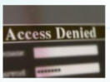
The It Act, 2000 - Objectives
To provide legal recognition for transactions:-
Carried out by means of electronic data interchange, and
Other means of electronic communication, commonly referred to as “electronic commerce”, involving the use of alternatives to paper-based methods of communication and storage of information.

Slide 37
The It Act, 2000 - Objectives
To facilitate electronic filing of documents with the government agencies
To amend the indian penal code, the indian evidence act, 1872, the banker’s book evidence act, 1891 and the reserve bank of india act, 1934.

Slide 38
Act is not applicable to…
(a) a negotiable instrument (Other that a cheque) as defined in section 13 of the negotiable instruments act, 1881;
(b) a power-of-attorney as defined in section 1a of the powers-of-attorney act, 1882;
(c) A trust as defined in section 3 of the indian trust act, 1882;

Slide 39
Act is not applicable to…
(d) a will as defined in clause 9h) of section 2 of the indian succession act, 1925 including any other testamentary disposition
(e) any contract for the sale or conveyance of immovable property or any interest in such property;
(f) any such class of documents or transactions as may be notified by the central goverment

Slide 40
Terms under IT ACT 2000
Adjudicating Officer
Digital signature
Affixing digital signature
Appropriate government
Certifying authority
Cyber appellate tribunal
Electronic form
Secure system
Electronic gazette

Slide 41

Impact on Banking Sector
Pressure from competition and regulatory environtment
Threat of competition and retaining customer base
It used for communication, connectivity and business process re-engineering
Improver efficiency of mony, capital and foreign exchange markets
Lead to convergence of computer and communication technology to enable tba (Technology Based Assessment )

Slide 42
Cyber law: Indian Culture And Government’s Role
“Any criminal activity that uses a computer either as an instrumentality, target or a means for perpetuating further crimes comes within the ambit of cyber crime”
need of cyber crime law:
Cyber space is an intangible and provides an extreme mobility
Events taking place on the internet are not happening in the locations where participants or servers are physically located, but “in cyberspace”.

Slide 43
Cyber law: Indian Culture And Government’s Role
2. Cyber space offers great economic efficiency
Billions of dollars worth of software can be traded over the internet without the need for any government licenses, shipping and handling charges and without paying any customs duty.

Slide 44
Cyber law: Indian Culture And Government’s Role
3. Cyber space has complete disrespect for national boundaries
A person in india could break into a bank’s electronic vault hosted on a computer in usa and transfer millions of rupees to another bank in Switzerland, all within minutes.
All he would need is a laptop computer and a cell phone.

Slide 45
Cyber law: Indian Culture And Government’s Role
4. Cyber space is absolutely open to participation by all
A ten year-old to an eighty year-old grand mother without any regard for the distance or the anonymity between them.

Slide 46
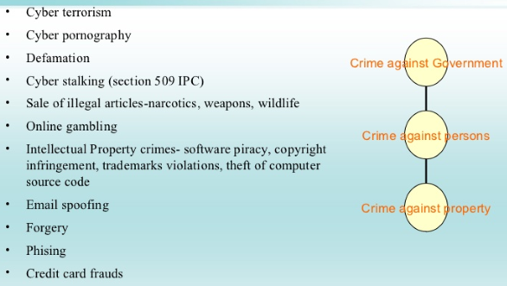
Cyber crimes: classification

Slide 47
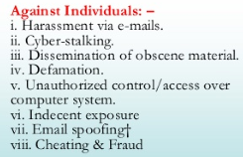
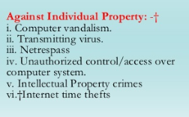
Cyber crimes: classification

Slide 48
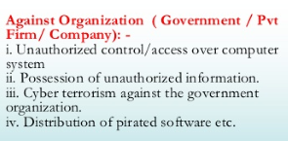
Cyber crimes: classification

Slide 49
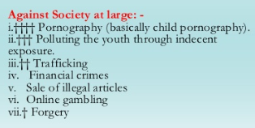
Cyber crimes: classification

Slide 50
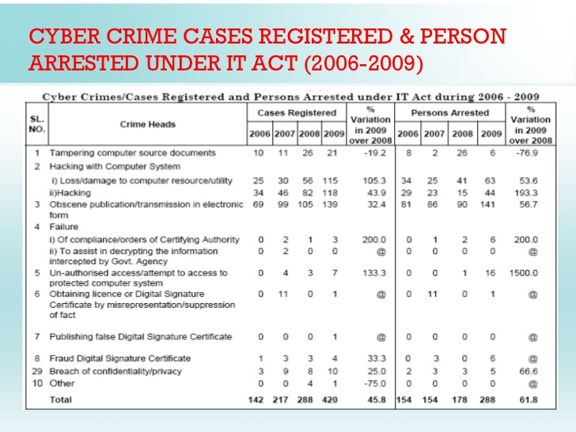

Slide 51
Cybercrime provisions under IT act, 2000
Tampering with Computer source documents Sec. 65
Hacking with Computer Systems, Data Alteration Sec. 66
Publishing obscence information Sec. 67
Un-authorized access to protected system Sec. 70
Breach of Confidentiality and Privacy Sec. 72
Publishing false digital signature certificates Sec. 73

Slide 52
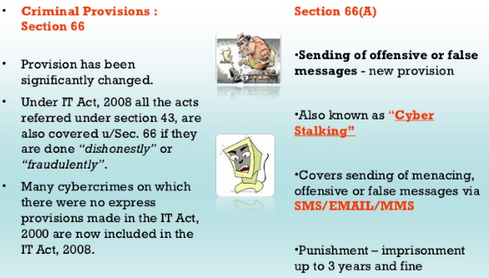
Amendment of IT Act 2000

Slide 53
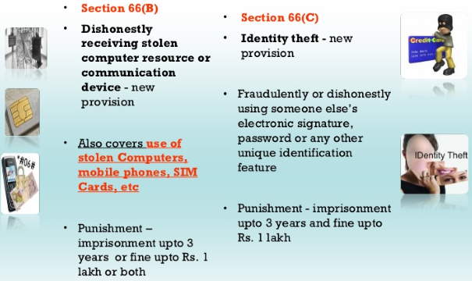
Amendment of IT Act 2000

Slide 54
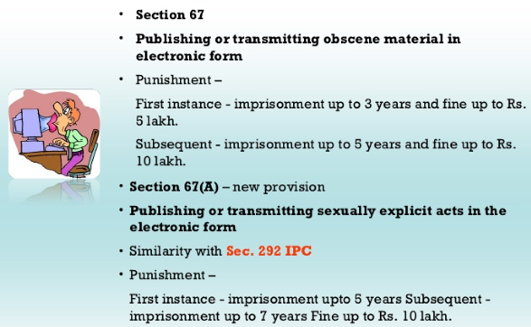
Cyber Pornograpghy

Slide 55
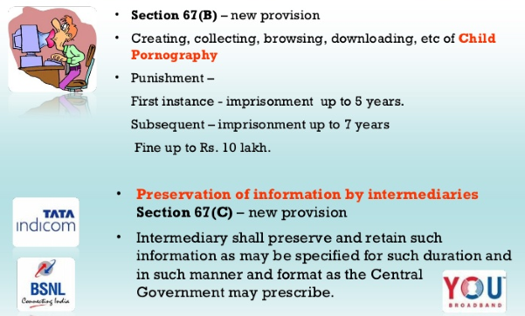
Cyber Pornograpghy

Slide 56
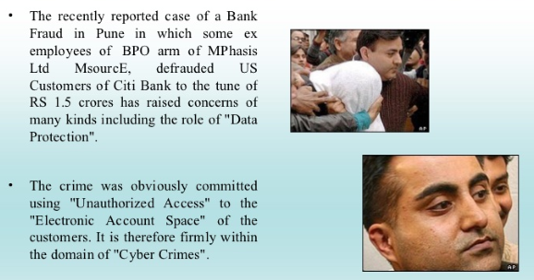
Famous BPO Cyber Crime Cases

Slide 57
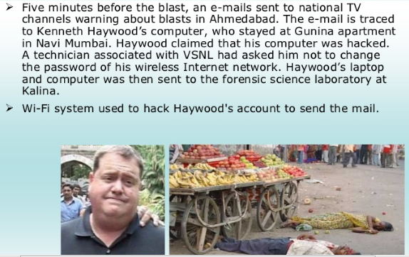
Ahmadabad Blast : Haywood

Slide 58

Malaysia law & computer crime

Slide 59
Introduction
This information By Chong Yew, Wong (GSEC Practical Assignment v1.2f) from SANS Institute

Slide 60
Introduction
Malaysia computer crimes act 1997 (cca 1997) and provide important guidelines for a successful computer crime investigation.
The enactment of the CCA 1997 is a step in the right direction for a developing country such as Malaysia as she sttempts to push herself towards a knowledge-based economy.

Slide 61
Introduction
However, having laws alone will not be sufficient to carry out trials against cyber criminals.
We will be looking into other important elements in a computer crime case, which includes good criminal investigation and the need to maintain close cooperation between different organizations and countries.

Slide 62
Overview of the computer crimes act 1997 (cca 1997)
Cca 1997 which is one of the many cyber laws enacted in Malaysia.
The following is a summary of the offences relating to misuse of computers as extracted from the explanatory statement” of the cca 1997.

Slide 63
Overview of the computer crimes act 1997 (cca 1997)
Seeks to make it an offence for any person to cause any computer to perform any function with intent to secure unauthorized access to any computer material.
Seeks to make it a further offence if any person who commits an offence reffered to in item (1) with intent to commit fraud, dishonesty or to cause injury as defined in the penal code.

